Slide 1
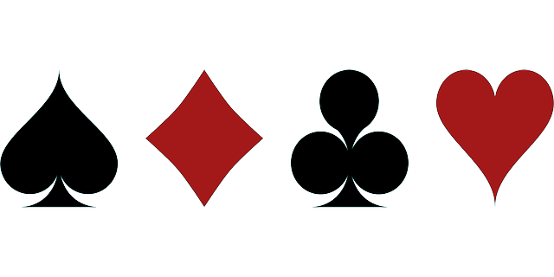
SPADES GAME
SPRINT 2 REVIEW MEETING
KillerCutThroat TEAM: 10

Slide 2
INDEX
Product Backlog Updated Product Backlog
Sprint Backlog Current Sprint Backlog
Task Board TaskBoard
Sprint Burndown Chart
Lessons learnt in this sprint.

Slide 3
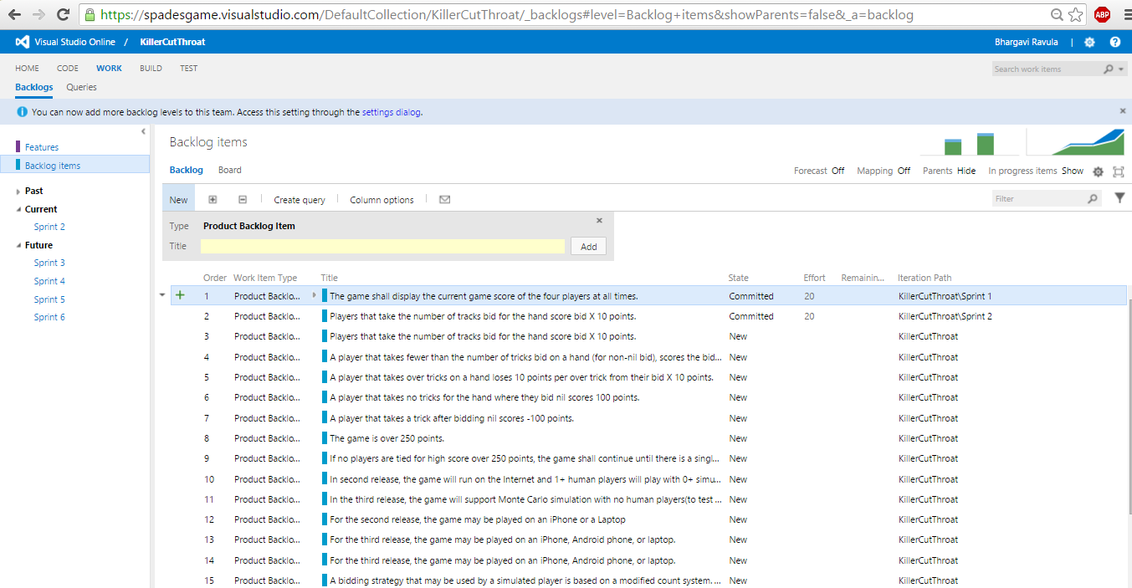
PRODUCT BACKLOG
The undone user-stories of the sprint 2 are projected on the backlog.

Slide 4
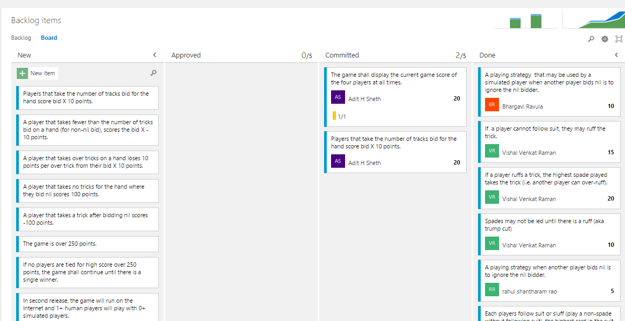
PRODUCT BACKLOG

Slide 5
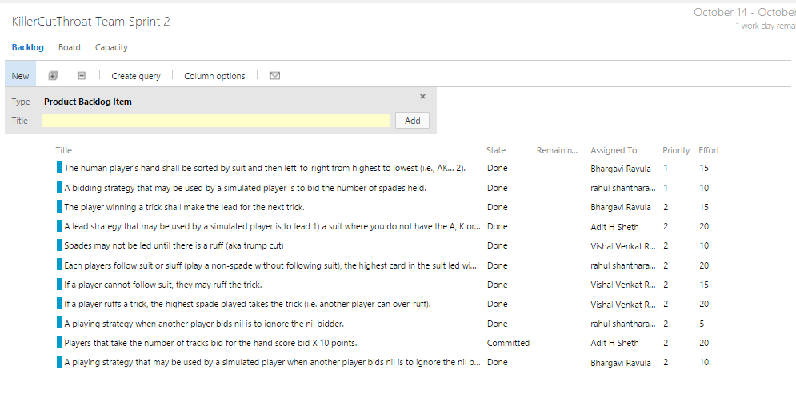
SPRINT BACKLOG

Slide 6
TECH STORIES
We’ve used Visual Studio Online(upgraded version of Team foundation Server). It is set of complementary cloud based services to helps a team write code better. It provides agile project management tools, build services, code, test and deploy.
We’ve used the Scrum development template for the project which allowed our team to effectively keep track of the user stories in the current sprint by maintaining product backlog, sprint backlog, task board and measure the progress using sprint burn down chart.

Slide 7
TECH STORIES
Image mapping techniques have been used on a series of images in an array so as to use the right image to display for the pictures of players by specifying the right pixel range while implementing the individual image.

Slide 8
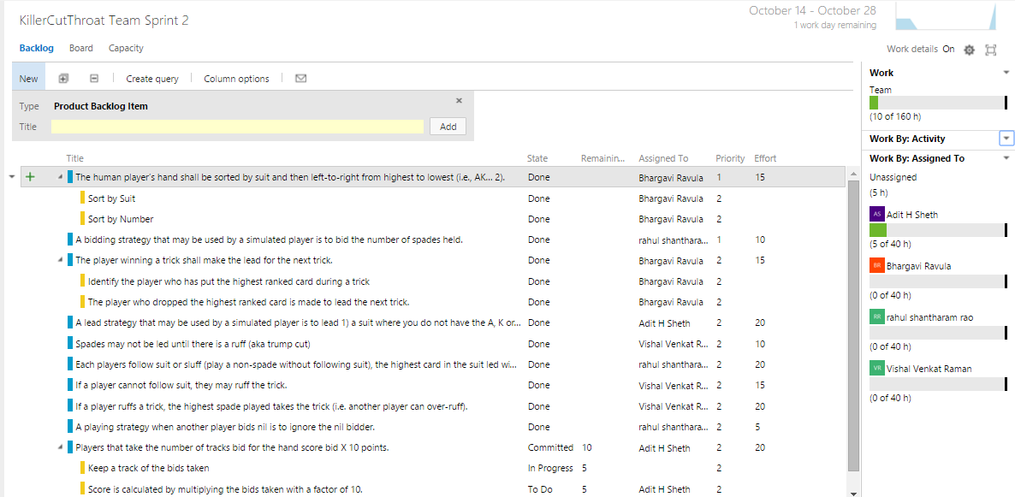
TASK BOARD

Slide 9
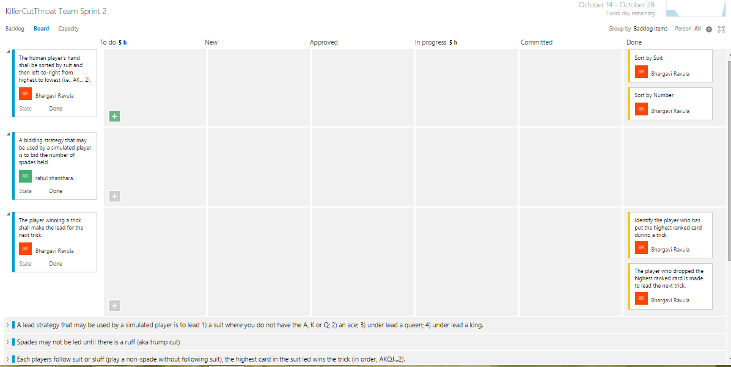
TASK BOARD

Slide 10
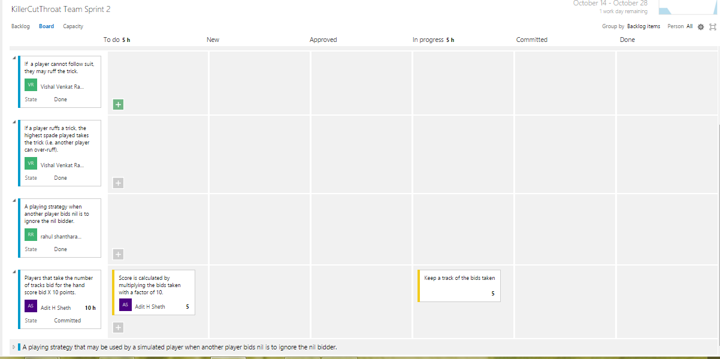
TASK BOARD

Slide 11
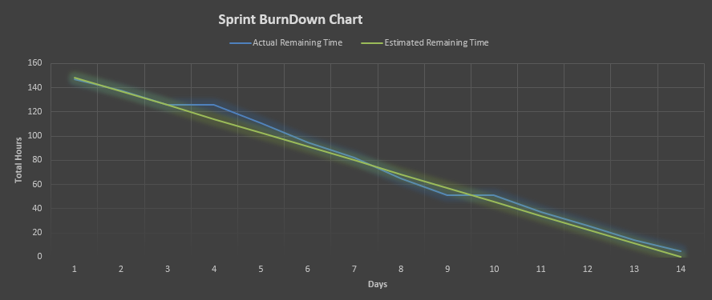
SPRINT BURNDOWN CHART

Slide 12
TEST CASES
SCENARIO | TEST STEP | EXPECTED RESULT | ACTUAL OUTCOME
Start the Game | To Press on the deal button | A player is selected in random and cards are distributed in a clockwise direction such that each player gets 13 cards | Each player gets 13 cards.
Make a bid | Select a number from 0 - 13 | The player to the left of the dealer bids first. The selected value is displayed next to the player name. | Bid value is displayed.

Slide 13
TEST CASES
SCENARIO | TEST STEP | EXPECTED RESULT | ACTUAL OUTCOME
Bid at the beginning of a hand | The player takes a lead. | Players may bid to take any number of tricks from 0(nil) to 13 at the beginning of a hand. | One value is selected.
Cards are clearly visible and sorted | The human player’s cards are shown and sorted based on the suit and number. | The cards are sorted in the descending order based on number. And the suit order followed is “Clubs, Diamonds, Spades and Hearts” | Sorted cards are displayed.

Slide 14
TEST CASES
SCENARIO | TEST STEP | EXPECTED RESULT | ACTUAL OUTCOME
Playing a hand | Player places his card following the suit or sluff | The highest card in the suit led wins the trick (in order, AKQJ...2). | Player who wins the trick scores
Playing a hand | Player when cannot follow suit, can ruff | The highest played spade wins the trick. | Player who wins the trick scores

Slide 15
LESSONS LEARNT IN THIS SPRINT
Pair programming doesn’t cost twice as much. Using pair programming style is said to decrease the programming hours spent on a task. But, care should be taken not to pair people who are new comers.
We often had discussions instead of a lecture from a single team member. Thus, there was no criticism thinly veiled as suggestions, but mutual discovery and agreement. And the team had the feeling of accomplishment.
Members of the team must have to trust each other. It may take time, but it does work.

Slide 16
WORKING IN PAIRS Team Capacity
DESIGN | Aadit Seth | Rahul Santharam Rao
DESIGN | Bhargavi Ravula | Vishal Iyer
DEPLOYMENT | Aadit Seth | Rahul Santharam Rao
DEPLOYMENT | Bhargavi Ravula | Vishal Iyer
REQUIREMENTS | Aadit Seth | Rahul Santharam Rao
TESTING | Vishal Iyer | Aadit Seth
DEVELOPMENT | Vishal Iyer | Bhargavi Ravula

Slide 17
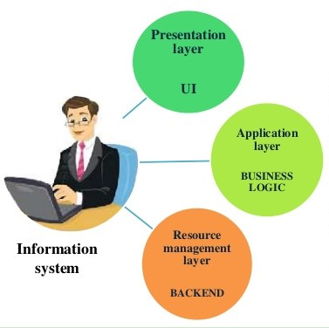
LESSONS LEARNT IN THIS SPRINT
A walking skeleton is a tiny implementation of the system that performs a small end to end function.
Since our application has only one human player and 3 simulated players we have chosen the 1- tier architecture style. It is the simplest, single tier on single user that is equivalent of running an application on a personal computer.
All the required components to run the application are located with in. User Interface, business logic and data storage are all located on the same machine.

Slide 18

Thank You

